Slide 1
Network Intrusion Detection
CAPSTONE PROJECT
Presented By:
Ashutosh Karemore
Manipal University Jaipur (BCA)

Slide 2
OUTLINE
Problem Statement
Proposed System/Solution
System Development Approach
Algorithm & Deployment
Result (Output Image)
Conclusion
Future Scope
References

Slide 3
Problem Statement
Network Intrusion Detection
Create a robust network intrusion detection system (NIDS) using machine learning. The system should be capable of analyzing network traffic data to identify and classify various types of cyber-attacks (e.g., DoS, Probe, R2L, U2R) and distinguish them from normal network activity. The goal is to build a model that can effectively secure communication networks by providing an early warning of malicious activities.

Slide 4
Proposed Solution
The proposed system aims to address the challenge of predicting the required bike count at each hour to ensure a stable supply of rental bikes. This involves leveraging data analytics and machine learning techniques to forecast demand patterns accurately. The solution will consist of the following components:
Data Collection:
Gather historical data on bike rentals, including time, date, location, and other relevant factors.
Utilize real-time data sources, such as weather conditions, events, and holidays, to enhance prediction accuracy.
Data Preprocessing:
Clean and preprocess the collected data to handle missing values, outliers, and inconsistencies.
Feature engineering to extract relevant features from the data that might impact bike demand.
Machine Learning Algorithm:
Implement a machine learning algorithm, such as a time-series forecasting model (e.g., ARIMA, SARIMA, or LSTM), to predict bike counts based on historical patterns.
Consider incorporating other factors like weather conditions, day of the week, and special events to improve prediction accuracy.
Deployment:
Develop a user-friendly interface or application that provides real-time predictions for bike counts at different hours.
Deploy the solution on a scalable and reliable platform, considering factors like server infrastructure, response time, and user accessibility.
Evaluation:
Assess the model's performance using appropriate metrics such as Mean Absolute Error (MAE), Root Mean Squared Error (RMSE), or other relevant metrics.
Fine-tune the model based on feedback and continuous monitoring of prediction accuracy.
Result:

Slide 5
System Approach
The "System Approach" section outlines the overall strategy and methodology for developing and implementing the rental bike prediction system. Here's a suggested structure for this section:
System requirements
Library required to build the model

Slide 6
Algorithm & Deployment
In the Algorithm section, describe the machine learning algorithm chosen for predicting bike counts. Here's an example structure for this section:
Algorithm Selection:
Provide a brief overview of the chosen algorithm (e.g., time-series forecasting model, like ARIMA or LSTM) and justify its selection based on the problem statement and data characteristics.
Data Input:
Specify the input features used by the algorithm, such as historical bike rental data, weather conditions, day of the week, and any other relevant factors.
Training Process:
Explain how the algorithm is trained using historical data. Highlight any specific considerations or techniques employed, such as cross-validation or hyperparameter tuning.
Prediction Process:
Detail how the trained algorithm makes predictions for future bike counts. Discuss any real-time data inputs considered during the prediction phase.

Slide 7
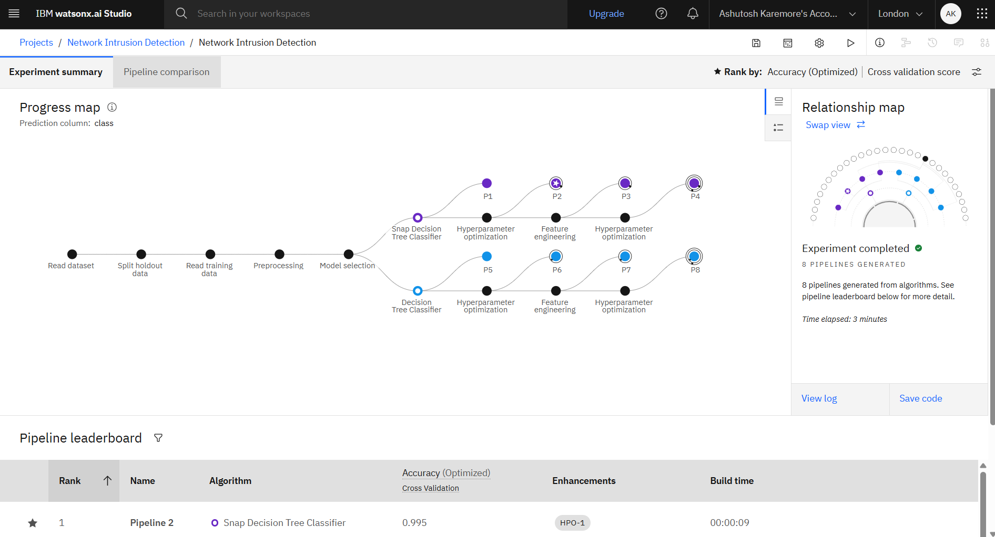
Result
Link to deployed model : https://eu-gb.ml.cloud.ibm.com/ml/v4/deployments/a1eeb2e4-9788-473d-953c-bce56dc707c1/predictions?version=2021-05-01

Slide 8
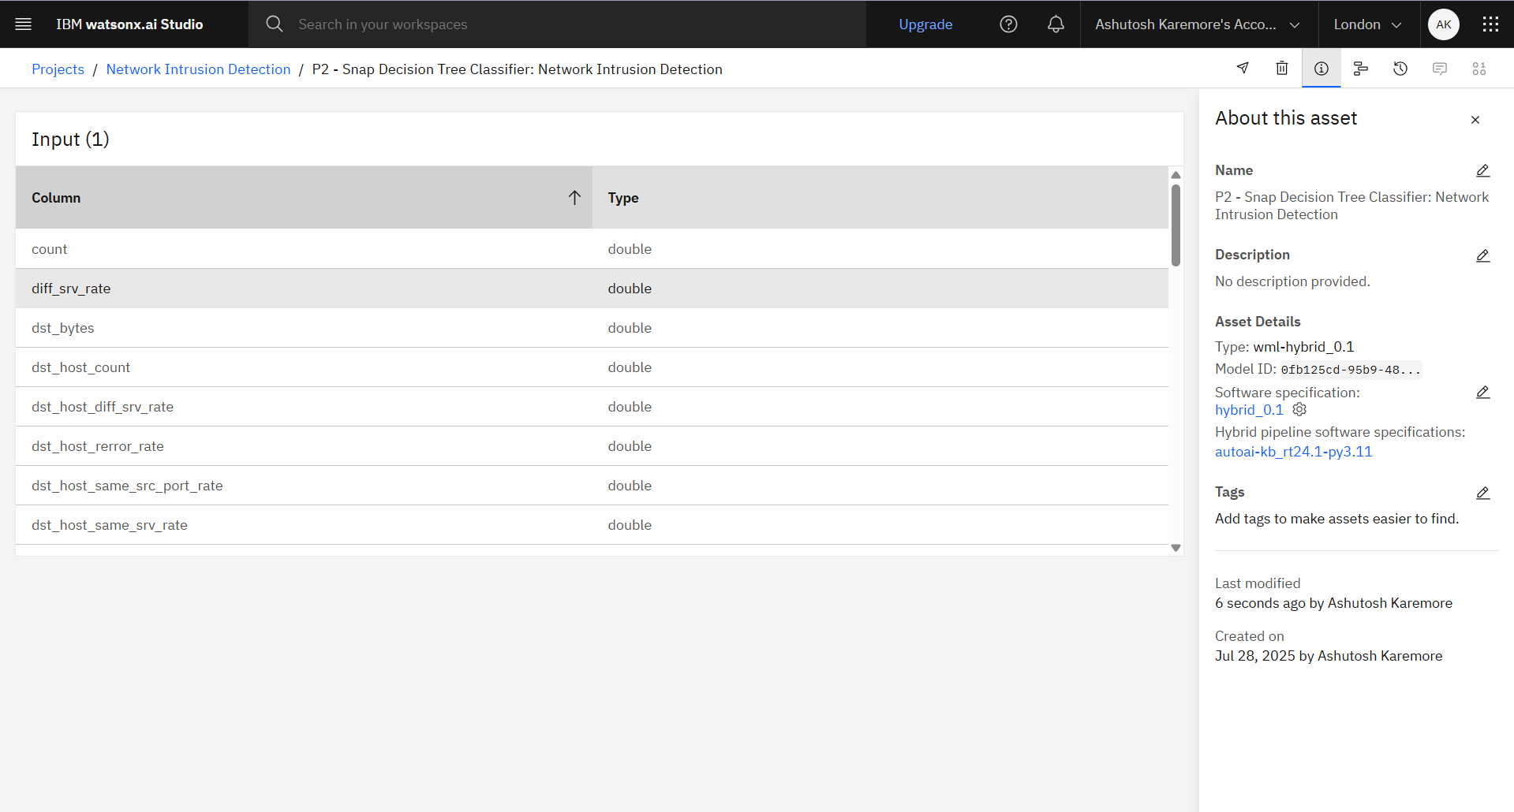
Result

Slide 9
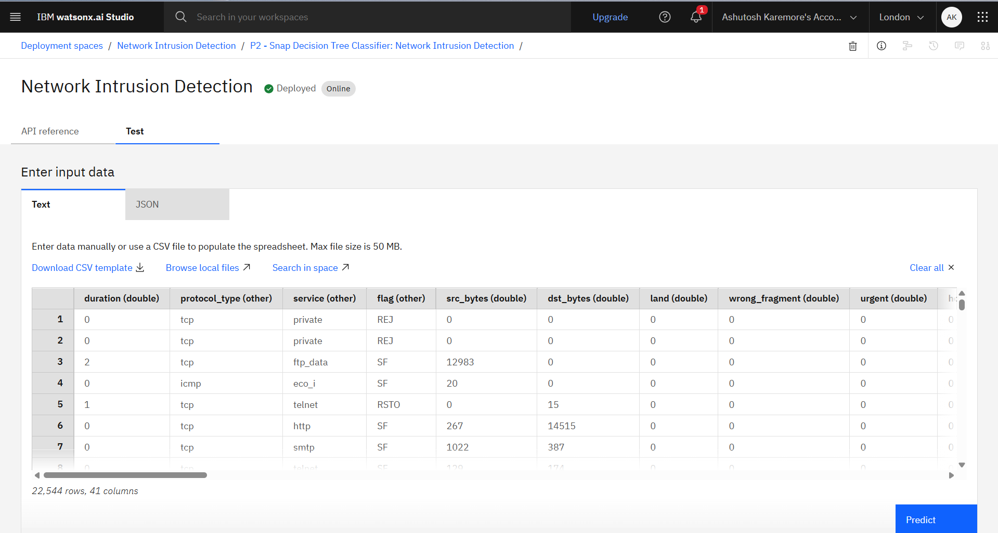
Result

Slide 10
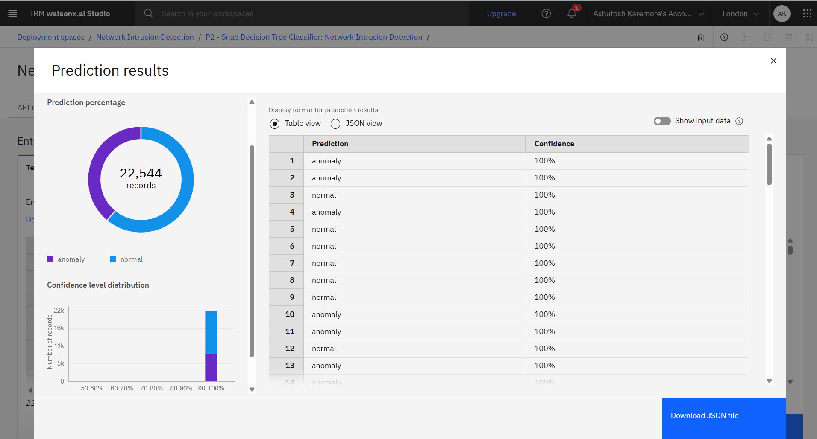
Result

Slide 11
Conclusion
Summarize the findings and discuss the effectiveness of the proposed solution. Highlight any challenges encountered during the implementation and potential improvements. Emphasize the importance of accurate bike count predictions for ensuring a stable supply of rental bikes in urban areas.

Slide 12
Future scope
Discuss potential enhancements and expansions for the system. This could include incorporating additional data sources, optimizing the algorithm for better performance, and expanding the system to cover multiple cities or regions. Consider the integration of emerging technologies such as edge computing or advanced machine learning techniques.

Slide 13
References
Decision Tree Classifier Paper : https://ieeexplore.ieee.org/document/6498972/
https://www.sciencedirect.com/science/article/pii/S1877050916311127
Dataset used: https://www.kaggle.com/datasets/sampadab17/network-intrusion-detection
https://cloud.ibm.com/docs
https://www.ibm.com/docs/en/watsonx/saas?topic=solutions-autoai-machine-learning

Slide 14
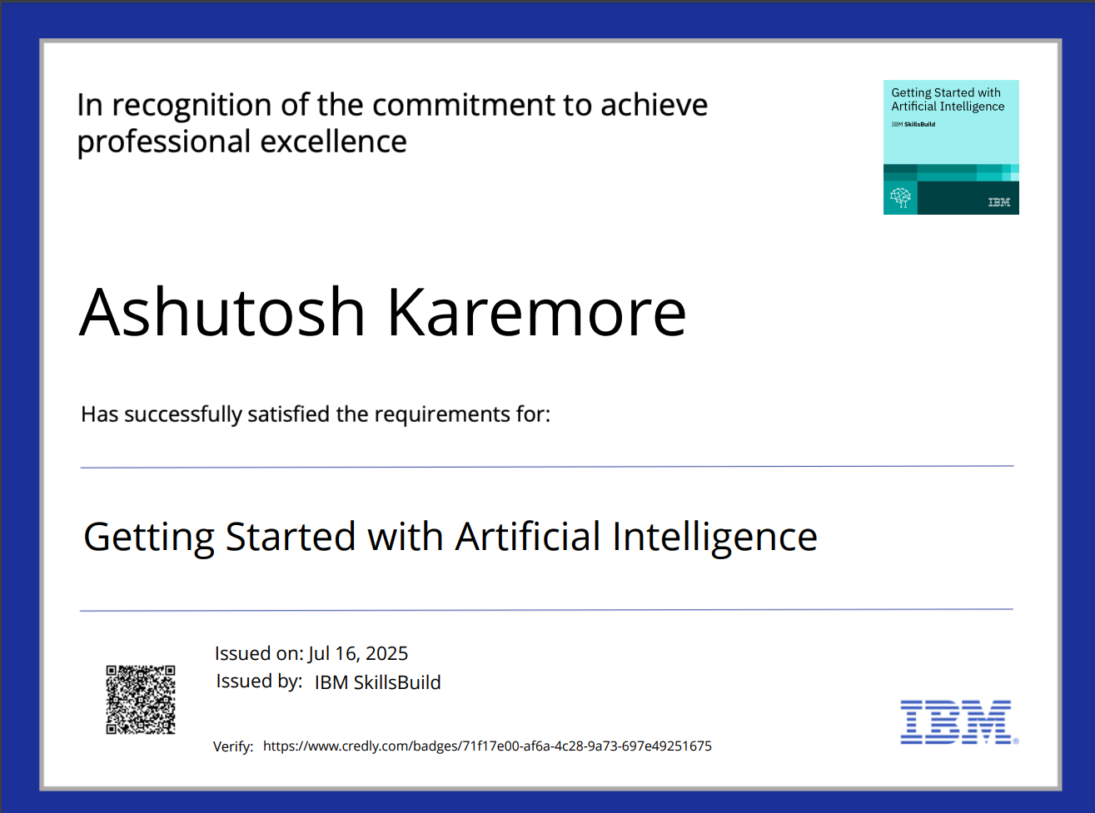
IBM Certifications

Slide 15

IBM Certifications

Slide 16
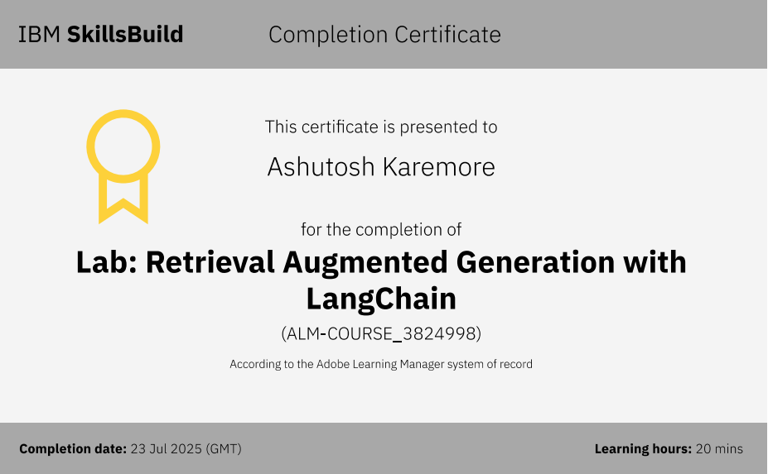
IBM Certifications

Slide 17
THANK YOU

